Slide 1
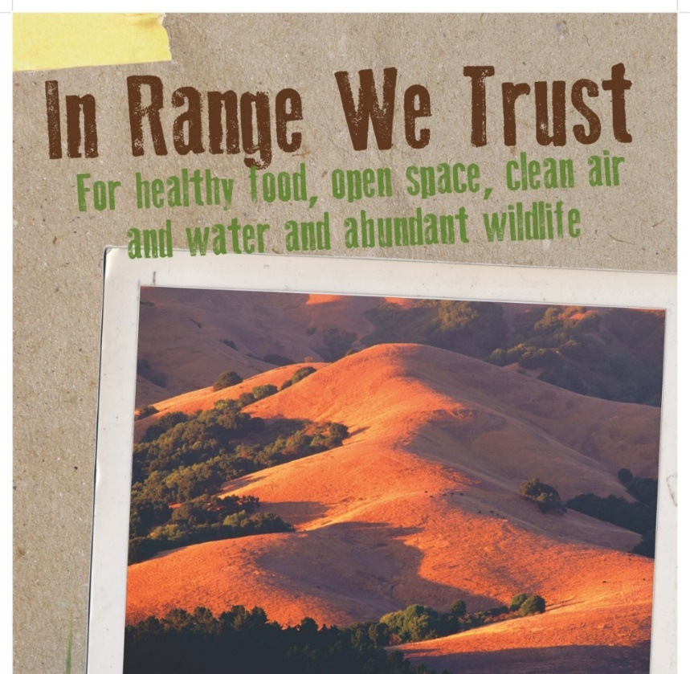
Conservation Easement
Project Tracking
A KEY TO PROJECT SUCCESS
Michael Delbar, COO
California Council of Land Trusts
March 7, 2018

Slide 2
ABOUT
2018 is our...
20th Anniversary
Founded in 1998 by members of
California Cattlemen’s Association

Slide 3
ABOUT
Part of the Livestock Industry
All Directors are members of
California Cattlemen’s Association

Slide 4
ABOUT
317,000 Acres under Conservation Easement
Filled a need in the ranching community

Slide 5
KEEPING TRUST
Over 300,000 acres
on our...
ACTIVE
Project List

Slide 6
KEEPING TRACK
Landowner
makes...
INTITAL CONTACT
All aspects of the process are discussed

Slide 7
INITIAL STEPS
Landowner...
completes
and submits
detailed application
Data helps determine possible funding sources

Slide 8
INITIAL STEPS
Staff or Director
performs...
SITE VISIT
Seeing the ranch first hand

Slide 9
INITIAL STEPS
Application and
Site Visit Report
reviewed by...
Conservation
Committee

Slide 10
INITIAL STEPS
Final Decision
made by...
Board of Directors
Typically at least one Director is familiar with ranch or family

Slide 11
SIMULTANEOUS ACTIONS
Depending on type of
conservation easement:
-Purchased
-Donated
-Mitigation

Slide 12
SIMULTANEOUS ACTIONS
Land Transaction Coordinator...
Begins drafting
agreements and reviewing
title docs
Donated easements are donated
by the landowner
er

Slide 13
SIMULTANEOUS ACTIONS
Grant Manager searches for...
FUNDING SOURCES
that match the
Conservation Values
Standard easements are purchased from the landowner

Slide 14
SIMULTANEOUS ACTIONS
Stewardship Manager reviews...
required tasks and determines
Stewardship costs
using Property
Analysis Record (PAR)
a bargain sale is when part of the easement value is funded and part is donated

Slide 15
SIMULTANEOUS ACTIONS
Conservation Director negotiates...
terms of the
CONSERVATION EASEMENT
and completes legal documents
Mitigation easements help to offset expected adverse impacts of development of farmland, habitat, or riparian areas and are paid for by the developer or mitigating group.

Slide 16
SIMULTANEOUS ACTIONS
Landowner encouraged to seek...
Legal and Tax
Counsel

Slide 17
CLOSURE
All funding pieces assembled
Conservation easement terms finalized

Slide 18
STEWARDSHIP TAKES OVER
Every project monitored with a...
‘Boots on the Ground’
approach
Maintains relationship with landowner

Slide 19
STEWARDSHIP TAKES OVER
Monitoring Reports
completed and distributed

Slide 20
KEEPING TRACK
Enter
LANDSCAPE
Land Conservation Software

Slide 21
KEEPING TRACK
Web-based platform tracks projects from
application
through
stewardship

Slide 22
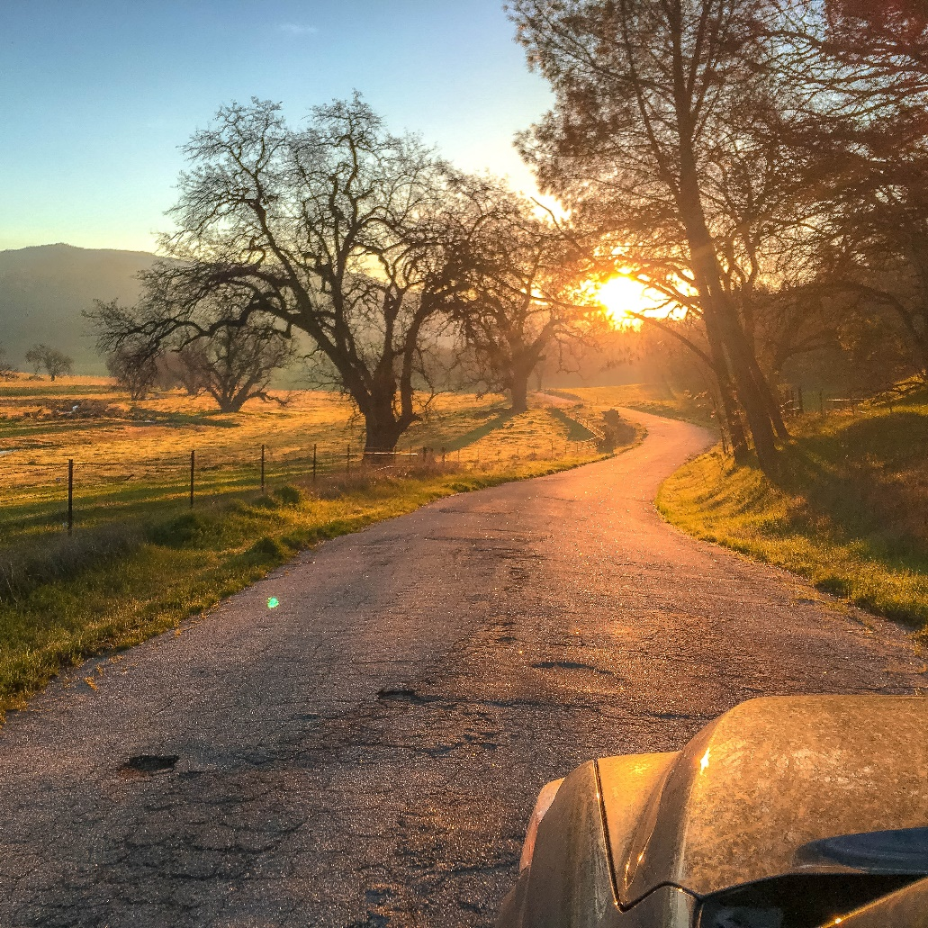
Questions?
info@rangelandtrust.org
www.rangelandtrust.org
Follow us: @RangelandTrust

